Slide 1

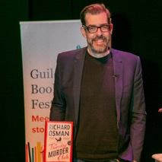
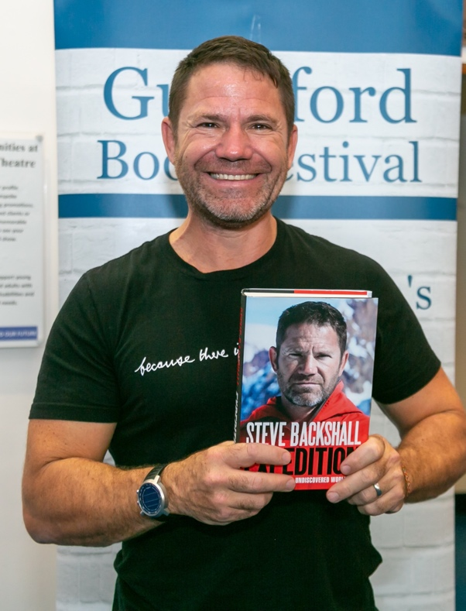
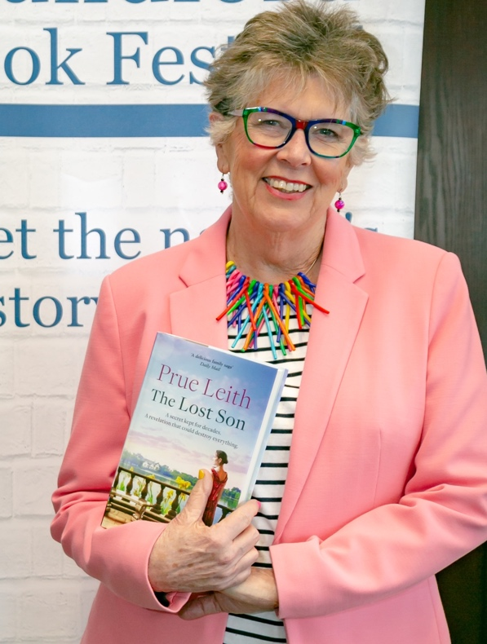
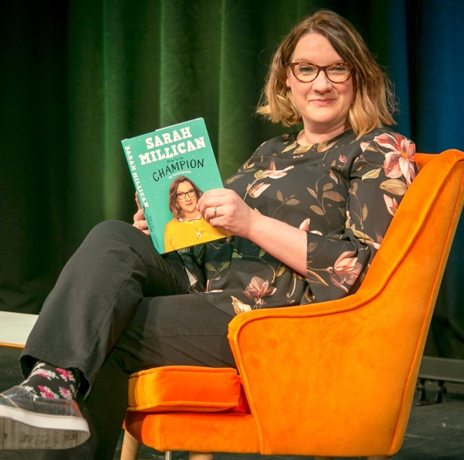
Guildford Book Festival
SPONSORSHIP OPPORTUNITIES
Sunday 2 - Sunday 16 October 2022
www.guildfordbookfestival.co.uk

Slide 2
Supporting the 2022
Guildford Book Festival
For over 33 years Guildford has hosted an annual Book Festival, with a mission to celebrate great writing and share a love of books with a wide and varied audience.
The Festival is the premier literary festival in the South-East and has established widespread support throughout the town and surrounding areas, reaching an audience of thousands.
An important element of the Festival is its schools and children’s programme in which authors and illustrators are invited to visit schools in the area to engage and inspire young readers.
In sponsoring Guildford Book Festival you are supporting our goal to promote books and reading to all ages whilst benefiting from
excellent brand exposure and audience reach.
With numerous events packed into over 14 days, the Festival attracts a vibrant mix of authors, artists and performers, providing the opportunity to offer a unique and memorable environment for corporate hospitality and staff incentives.
We work with companies and brands to ensure that effective partnerships are created that deliver your business and brand goals.
www.guildfordbookfestival.co.uk
www.guildfordbookfestival.co.uk

Slide 3
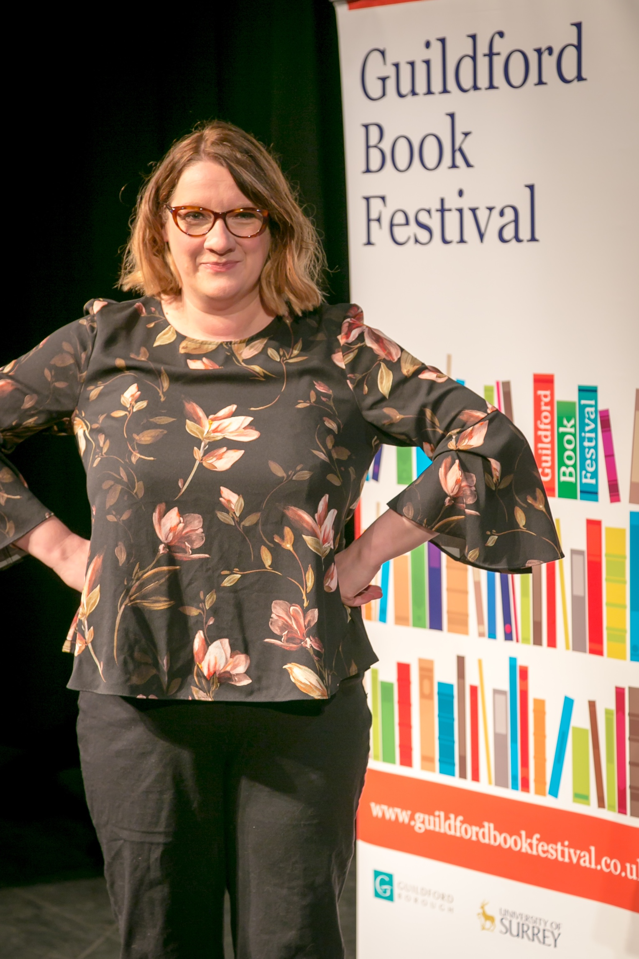
“The GBF team worked very hard to ensure our needs were met, and we were very impressed by their attitude, their organisation and the calibre of speakers they had at the Festival. We will certainly be signing up for more!”
Ken Young, Wilkins Kennedy

Slide 4
FESTIVAL OVERVIEW
More than 5,000 tickets sold
80% of tickets sold
ABC1 audience with a high level of disposable income
Exciting Events: Bringing bestselling authors, sporting heroes, prominent commentators, popular chefs, critically acclaimed historians, influential journalists and stars of the screen to share their stories and lives with the public.
Festival Hub: The Electric Theatre is the Festival hub incorporating the Festival bookshop, run by Waterstones, Guildford’s leading bookshop, the Green Room and main theatre. Other events take place in and around the town, combining historical and smaller venues with large theatres and auditoriums.
Highly Engaged Audiences: The Festival creates a space for friendly discussion and debate with events for everyone on offer from literary lunches and coffee mornings to lively conversations and in-depth panel discussions.
Inspiring Young Readers: Our schools programme and family events include large and small village school events, family shows, writing and illustration workshops.
www.guildfordbookfestival.co.uk

Slide 5

“Listening, learning, laughing. Literature both light and lofty. What's not to love about the Guildford Book Festival?”
Sandi Toksvig

Slide 6
SPONSORSHIP PACKAGES
Guildford Book Festival offers a fantastic range of corporate sponsorship and hospitality opportunities to suit any budget. We offer an innovative way to interact with consumers as well as the opportunity to entertain staff or clients in a unique and memorable way.
We work in partnership with companies to tailor a package of benefits to fit your specific objectives:
Build awareness and shape your corporate identity through our wide-reaching marketing channels and on-site branding
Develop platforms for corporate and social responsibility programmes
Reach out to our audiences with sales and sampling opportunities
Engage clients and staff with exclusive and rewarding hospitality experiences with unique access to top-name personalities
Fund our work and education projects – become part of key events in the region’s cultural calendar to achieve your Corporate Social Responsibility agenda
Associate your company or brand with an individual event or a collection of events that match your brand identity or company values
Sponsorship of weekday events starts from as little as £350, with evening or weekend events starting at £500.
www.guildfordbookfestival.co.uk

Slide 7
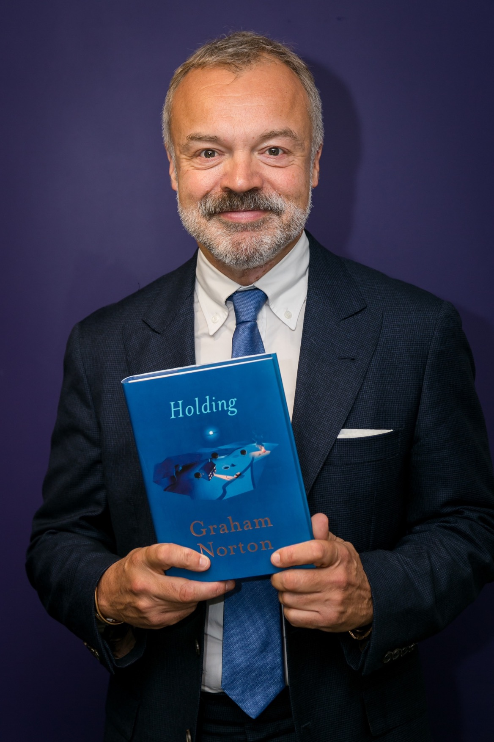
“The team are great to work with and it's really good to get involved with our local community.”
“it was a very enjoyable evening… the meet and greet with Arlidge went well and he was both interesting and amusing.”
The Rutland Group
Valerie Robinson, Allianz

Slide 8
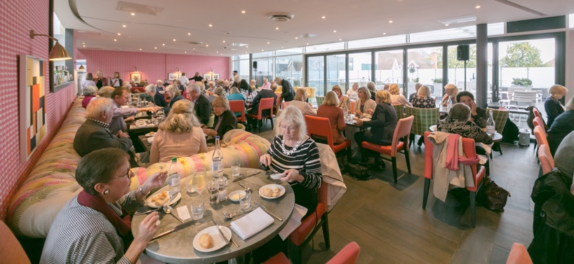
READERS’ DAY SPONSOR
Readers’ Day is a mini festival in a day, featuring up to 8 handpicked authors and professionals from the world of publishing. This interactive and enjoyable day for book lovers has been a popular feature of the Festival for many years and is always a guaranteed sell out.
Promotion in all Festival literature regarding Readers’ Day
Complimentary tickets
Invitations to the Festival launch
Opportunity to meet Readers’ Day authors and speakers
Ability to offer samples in the goodie bag
Opportunity to display literature and have a stand at the event
LITERARY LUNCH SPONSOR
Enjoy a delicious two-course lunch in the company of two fantastic authors - this is another hugely popular event for the Festival.
Promotion in all Festival literature regarding the Literary Lunch
Complimentary tickets
Invitations to the Festival launch
Opportunity to meet Literary Lunch authors and speakers
Opportunity to display literature and have a stand at the event
www.guildfordbookfestival.co.uk

Slide 9
DIGITAL SPONSOR
The Guildford Book Festival website is the primary ‘shop window’ for the Festival and your name/logo would be on every page of the website and on every email newsletter. You would also receive the following benefits:
Digital screen advertising at the Festival’s central venues
Presence on the Festival website homepage
Dedicated webpage for your brand on your website
Promotion in all Festival email newsletters
Complimentary tickets
Invitations to the Festival launch
Signed copies
Creative Writing courses are available over five weekdays for writers just starting out and more advanced writers. The perfect experience to offer some of your employees or the perfect sampling opportunity.
Promotion in all Festival literature regarding Creative Writing courses
Complimentary tickets
Invitations to the Festival launch
Signed copies
Opportunity to meet Creative Writing course guest speakers
Ability to offer samples in the goodie bag
Opportunity to display literature and have a stand at the course
CREATIVE WRITING COURSE
www.guildfordbookfestival.co.uk

Slide 10
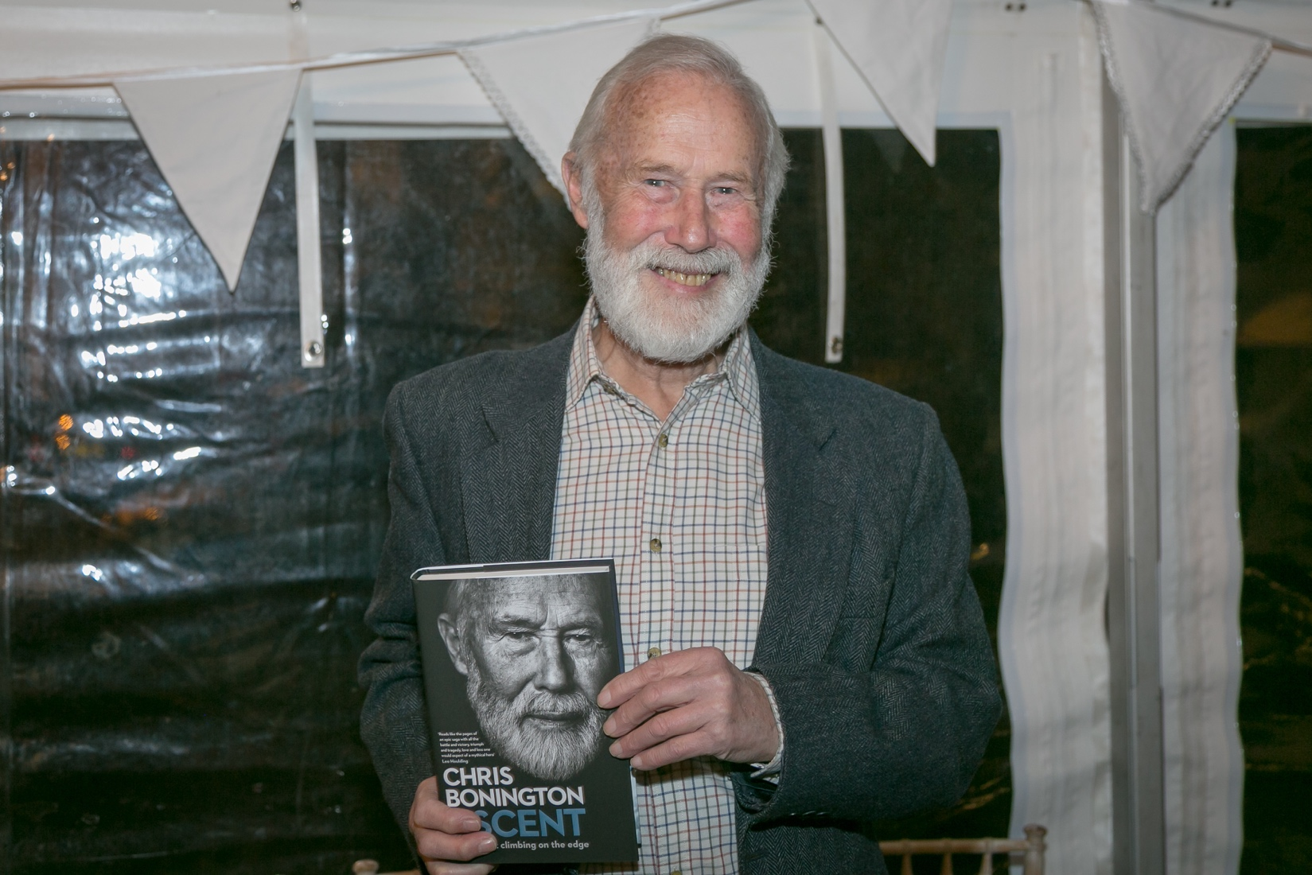
“I had a wonderful warm response from the audience at Guildford Book Festival with an excellent interview – All in all, a great and rewarding experience”
Sir Chris Bonington

Slide 11
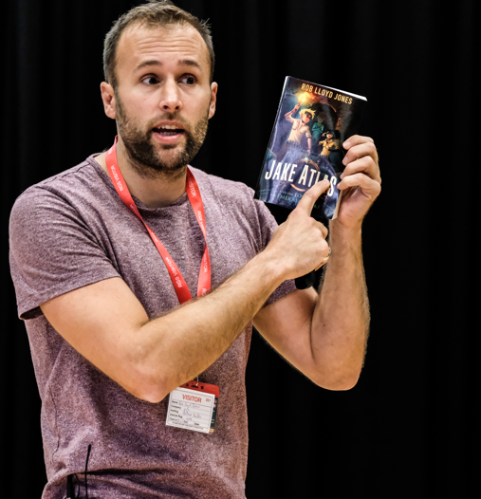
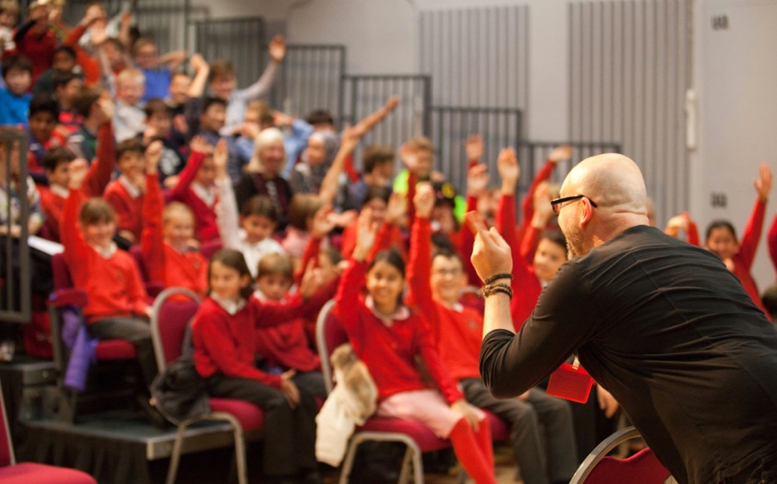
SCHOOLS SPONSOR
During the first and second week in July we stage author events in schools through the local area, with the aim to inspire a love of reading and writing among young people.
In 2021 we engaged with over 2,400 children and visited 17 schools. Associate your brand with the schools programme and benefits can include:
Branding across all channels and marketing materials relating to the schools programme
A half page advert inside the Festival brochure
Ability to offer branded bookmarks/pens/pencils for children at events
Credit in the schools and sponsors’ pages of the Festival website and brochure
Invitation to Festival launch
Opportunity to meet authors and speakers
www.guildfordbookfestival.co.uk

Slide 12
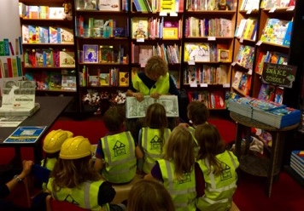
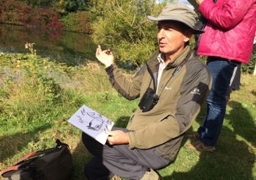
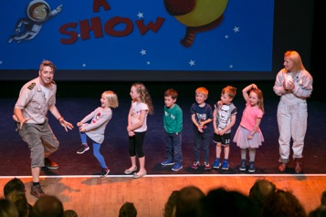
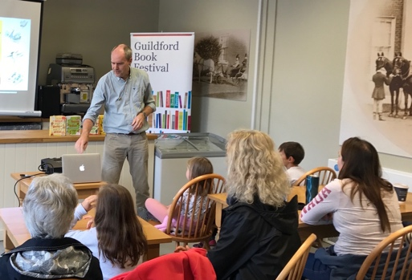
THE CHILDREN’S FESTIVAL
Children and families are vital to the programme with something on offer for every age from Lauren Child to Steve Backshall.
We are looking for sponsorship for single children’s events priced starting from £150.
There is the opportunity to shape the children’s Festival to suit your company’s objectives and have the naming rights to the children’s program.
Individual Children’s events range from £150 to £600.
www.guildfordbookfestival.co.uk
www.guildfordbookfestival.co.uk

Slide 13
TAILOR-MADE PACKAGES
Guildford Book Festival will happily put together bespoke packages to suit your company and requirements. We can even approach publishers with author requests.
As part of your package, the following opportunities are available:
Credit in the Festival brochure and on the Guildford Book Festival website
Complimentary tickets to your event
Invitation to the Festival launch party
Ability to offer samples or goodies to attendees
Meet the authors and artists
Photo opportunities with authors and artists
Signed copies of books
Ability to purchase corporate hospitality packages to network with your guests
Create your own space or installation at the Festival providing free interactive activities
Fund a Festival Education project or event in line with your CSR objectives
For more information on sponsorship including bespoke packages please contact:
Alex Andrews
Email: alexandrews@guildfordbookfestival.co.uk
Telephone: 07988 574290
www.guildfordbookfestival.co.uk

